Slide 1




JSPM’s
Bhivarabai Sawant Institute of Technology & Research
Accredited with ‘A+’ Grade by NAAC and NBA
Department of Information Technology
Project Presentation
“Web Application Fuzzer ”
Presented By ::
Mr. Lokesh Pusdekar (B400730362)
Mr. Siddhant Mane (B400730348)
Mr. Shubham Khaire (B400730342)
Mr . Pramod Kedar (B400730341)
Guided By : Prof. Pranita Ingale HOD: Dr. Vinod Wadne

Slide 2
Content
Introduction
Motivation
Problem Statement
Literature Survey
Objectives
Existing System vs Proposed system
Methodologies
Block Diagram/ System Architecture
Requirements(Software/ Hardware)
DFD Diagrams
UML Diagram (Use case, Class dig, Activity dig, Sequence dig)
Project Plan
Conclusion
References

Slide 3
Introduction
The Fuzzer sends random or semi-random inputs(Payloads) to the application, allowing developers and security testers to identify potential security flaws before they can be exploited.
Web application fuzzing is a powerful technique for discovering security vulnerabilities in web applications.
It is an automated way to detect issues such as SQL injection, Cross-Site Scripting (XSS), and buffer overflow attacks, Path traversal, open Redirection.

Slide 4
Motivation
Ensuring the security of these applications is crucial, and fuzzing offers an automated approach to identifying potential security risks.
The motivation behind developing a web application fuzzer is to proactively detect vulnerabilities that could otherwise lead to data breaches, downtime, or reputation damage.

Slide 5
Problem Statement
“To develop an automated web application fuzzer that detects security vulnerabilities like SQL Injection and XSS using machine learning-based techniques, aiming to improve accuracy and reduce manual testing efforts.”

Slide 6
Literature Survey
Sr No | Paper Name | Authors | Publication Year | Conclusion
01 | Fuzzing Framework for server side web application | Arya Dharmaadi | 2024 | This study reviews the state-of-the-art fuzzing frameworks for testing web applications through web api
02 | Fuzzing techniques in web application and beyond | Danyang Zhao | 2020 | This study discusses the current situation of the fuzzing technique used in both web and other applications.

Slide 7
03 | Blackbox fuzzing approaches to secure web application | Assel Alsaedi , Abeer Alhuzali , Omaimah Bamasag | 2021 | In this black box fuzzing approach it can achieve better performance when considering the inner state of applications, dynamic features and input generation.
04 | Effective fuzzing of web application for server side vulnerabilities | Emre Guler , Sergej Schumilo , Moritz Schloegl , Nils Bars , Philipp Gorz | 2022 | A snapshot based feedback – driven fuzzing method tailored for PHP- based web applications .
05 | Machine learning –Based Fuzz Testing Techniques | AO Zhang, Yao XU, Cong Wang, Siwei li | 2024 | The present study investigates the application of machine learning in the field of fuzzing based on extensive review of the relevant literature.

Slide 8
Objectives
To Automate the process of vulnerability detection.
To Detect vulnerabilities like SQL injection, XSS, CSRF, and more.
To Ensure scalability and support for various input vectors (URL, headers, cookies, forms.
To Generate detailed reports on vulnerabilities found for further remediation.
To Provide a user-friendly interface for easy configuration and results analysis.

Slide 9
Existing System
Overview: - Traditional fuzzing tools rely on predefined inputs and rules to test web applications for vulnerabilities.
Detection Mechanism: Rule-based detection, often focusing on specific vulnerabilities (e.g., SQL injection, XSS).
Adaptability: Limited; unable to learn from previous tests or adapt to new attack vectors dynamically.
Efficiency: Can generate a high volume of requests but may miss nuanced vulnerabilities due to lack of contextual understanding.
Limitations: - High false positive/negative rates. - Inability to prioritize tests based on risk or context. - Inefficient in exploring deeper application logic.

Slide 10
Proposed System
Input Generation: Dynamic input generation using learned patterns from historical data, user behavior, and application logic.
Detection Mechanism: ML models analyze responses to identify potential vulnerabilities, adapting to new threats in real time. -
Adaptability: High; the system can continuously learn from new data, refining its models and approaches to fuzzing. -
Efficiency: More effective at identifying complex vulnerabilities due to deeper analysis and contextual understanding. -
User Interaction: Enhanced interface for configuration, feedback incorporation, and analysis of results.

Slide 11
Software Requirements
Software Requirements :
Languages: Python
Tools : Vs Code / Pycharm
Modules : Time , Request , logging , OS , uuid , csv , selenium, urlparse & etc
Machine Learning Modules: numpy, time, pandas, Joblib, sklearn, SMOTE
Xampp Control Panel
DVWA (Damm Vulnerable Web Application)
Browser(Firefox)
Frontend : Type script, React, Vite, Tailwind CSS, Socket IO, React Router.
Backend: Python Flask, Flask Socket IO, Sklearn
Operating system :
Windows/Linux

Slide 12
Hardware Requirements
Hard Disk:
Minimum of 250 GB or higher(for storage or report, generated Logs, and Wordlist).
RAM (Random Access Memory):
- 6 GB or more (for handling machine learning processes and Continuous request sending and response capturing efficiently).
Processor:
- Intel i5 or higher (to support multi-threading, Wordlist & request/response computation,
and machine learning algorithms).

Slide 13
Machine Learning
Random Forest:
The Random Forest model is used in the fuzzer to classify web responses as vulnerable or non-vulnerable. It is an ensemble learning technique that builds multiple decision trees and aggregates their predictions to improve accuracy.
The model is trained on a dataset containing labeled web responses, considering features such as status codes, response length, payload reflection, and execution time.
It enhances fuzzing efficiency by reducing false positives and improving the detection of known vulnerabilities.

Slide 14
Anomaly Detection (Anomaly Forest):
The Anomaly Forest approach, based on unsupervised learning, detects zero-day vulnerabilities and unexpected response patterns. It learns normal web behavior and flags deviations as anomalies.
The model assigns an anomaly score to new responses, marking them as potential security risks if they exceed a predefined threshold.
Key techniques include Isolation Forests, which efficiently isolate suspicious responses. This method ensures real-time adaptation to evolving security threats, making the fuzzer more effective against unknown attacks.

Slide 15
GPT-2 Model & GPT-2 Tokenizer:
In the context of a web application fuzzer, GPT-2 (Generative Pre-trained Transformer 2) can be utilized to generate intelligent and context-aware payloads for security testing.
When applied to fuzzing, GPT-2 can be trained or fine-tuned on datasets containing known attack patterns, such as SQL injection, XSS, or command injection, and then used to generate diverse, realistic, and dynamic payloads.
To interface with GPT-2, the GPT-2 tokenizer plays a critical role. The tokenizer converts plain text into tokens (numeric representations) that the model can process.
It breaks down complex text inputs into subwords or word fragments using a method called Byte Pair Encoding (BPE). This allows GPT-2 to handle a wide range of text inputs, including uncommon or partial words, which is especially useful in the security domain where inputs might include code fragments, special characters, or unconventional syntax.

Slide 16

Block Diagram
Machine learning
Test Case Generation
Fuzzing
Param’s Selection
Pre-Processing
Getting
Response
Generation of Logs
Wordlist
User
Input
Payloads
Execution
Alerts
Generating
Report
Errors
yes
Vulnerability
No

Slide 17
DFD – 0 LEVEL Diagram
Website
Response(Parameters)
Request(Parameters)
URL’s
Input
Fuzzing
Output
Result
Wordlist

Slide 18
DFD Level - 1 Diagram
Website
URL Input
Add Wordlist
Request
For
Parameters
Response
For
Parameters
Record Logs
Fuzzing
Process
Data Storage
Report

Slide 19
DFD Level - 2 Diagram
Pre-Processed
Data
URL Input
Add Wordlist
Add website URL
Request
For
Parameters
Website
Data Storage
Response
For
Parameters
Webpage
Parameters
Login
Page
Error
Fuzzing
Process
Report
Record Logs

Slide 20
DFD Level - 3 Diagram
Selenium Automation
Data Storage
Pre-Processing
Of Data
Starting of
Browser
URL Target
Input
Add
Wordlist
Add Website
URL
Load Wordlist
Login
Webpage
Fuzzing Engine
Request (Param’s)
Navigate Target Webpage
Generating/Recording Logs
Response
(Param’s)
Performing
Attack
Checking Response code
Generating
Report
RESULT

Slide 21
Sequence Diagram
User
Fuzzer
Pre-Processing
ML
Model
Web
Application
Response
Analyzer
Report
Generation
Initialize
Fuzzing
Initialize Model
Request for
Parameters
User
Input
Provided input
Parameter Input
Return Generated
Input
Provide Input
Send Input
Return Response
Analyze Response
Return Vulnerability
Result
Generate Report
Vulnerability
Report

Slide 22
Uml Use Case Diagram
Configure Fuzzer
Initiate Fuzzing
Admin
Generate Inputs
Send Inputs to Web App
Analyze Responses
Generate Report
Learn from Previous Tests
User
Use Case

Slide 23
Uml Class Diagram
Fuzzer
Report
Attributes:
Name : String
Version: String
Attributes :
- Report Id : String
Methods:
+Initialize()
+start Fuzzing()
Methods :
- Generate Report()
Request Handler
Response Analyzer
Attributes :
- Request Type : String
Attributes :
- Response code : Init
Methods:
+Process Request()
Methods :
+ analyze response()

Slide 24
UML Activity Diagram
Start
Initialize Fuzzer
Set Fuzzing Parameters
Launch Fuzzing Test
Capture And Analyze Response
Generate Vulnerability Report
END

Slide 25
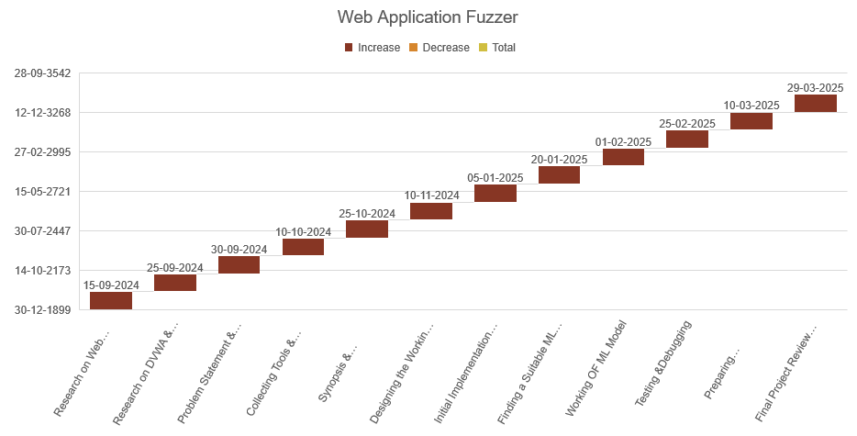
Project Plan

Slide 26
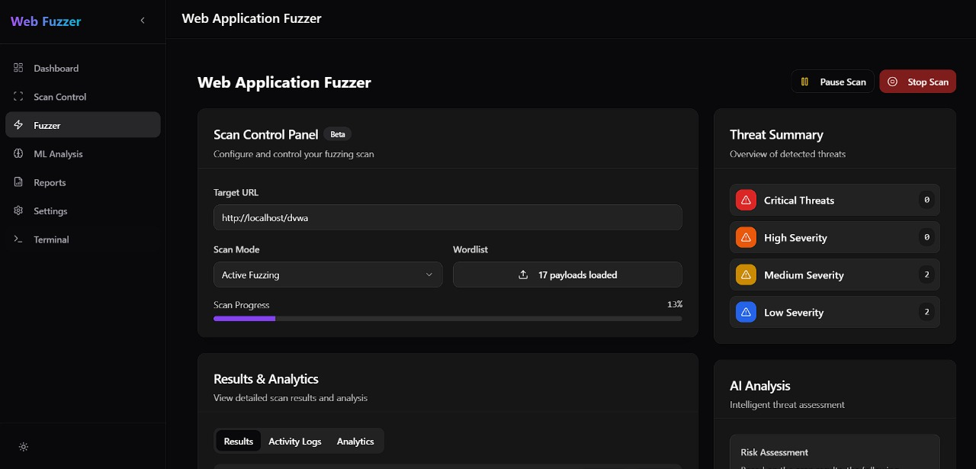
Initialization of Web_Fuzzer

Slide 27
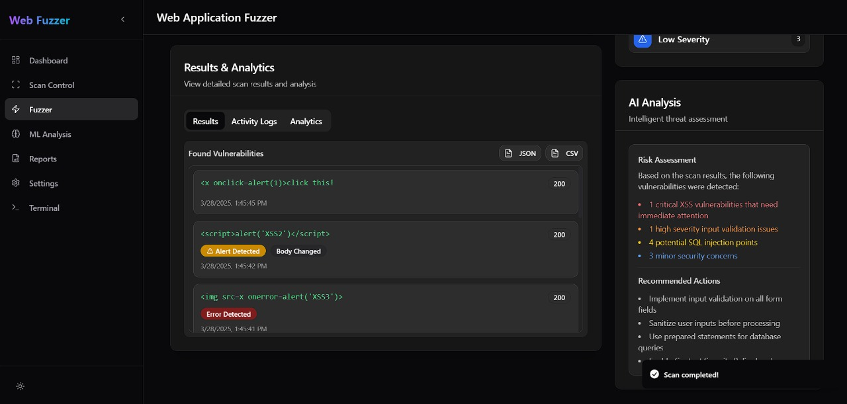
Result & Analytics

Slide 28
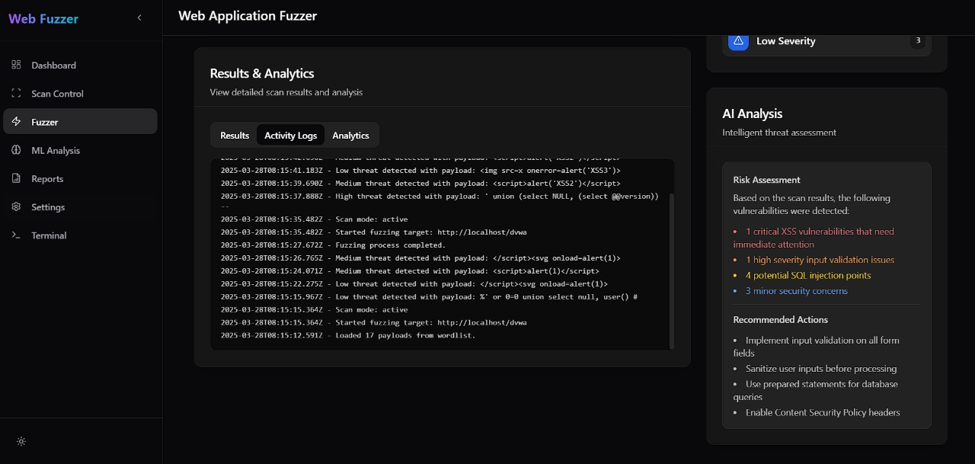
Activity Logs

Slide 29
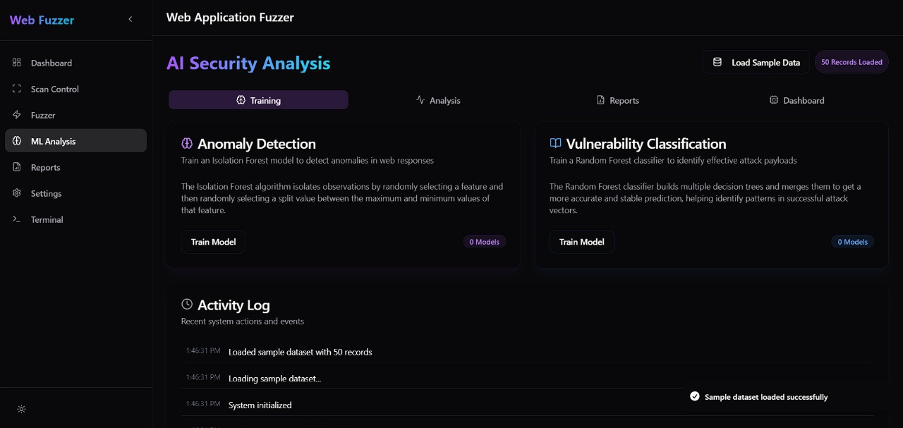
Model Training

Slide 30
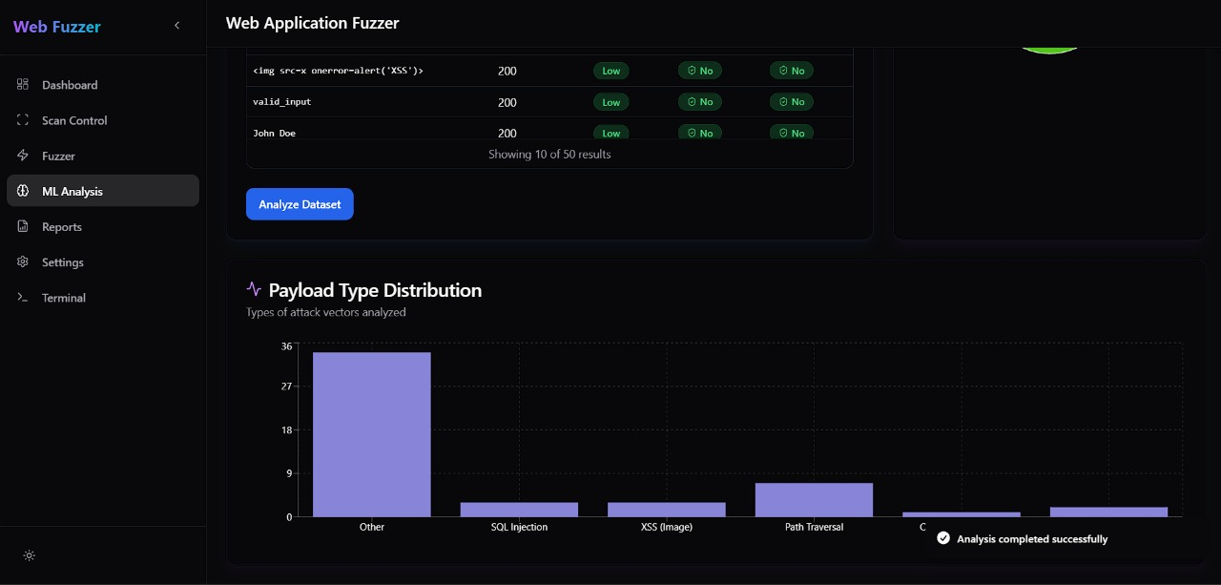
Storing the Response Data for ML Model

Slide 31
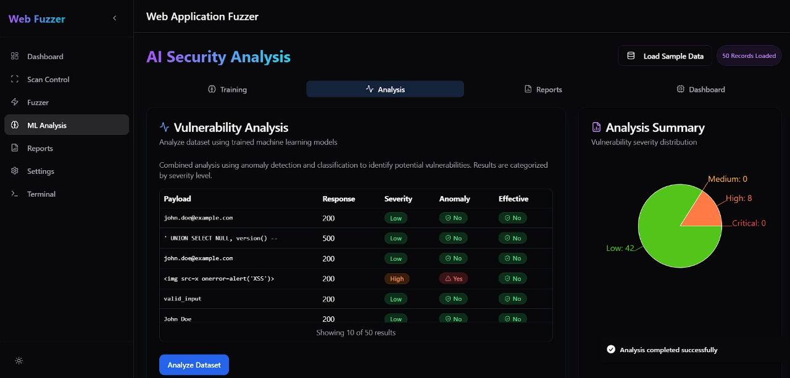
Vulnerability Analysis

Slide 32
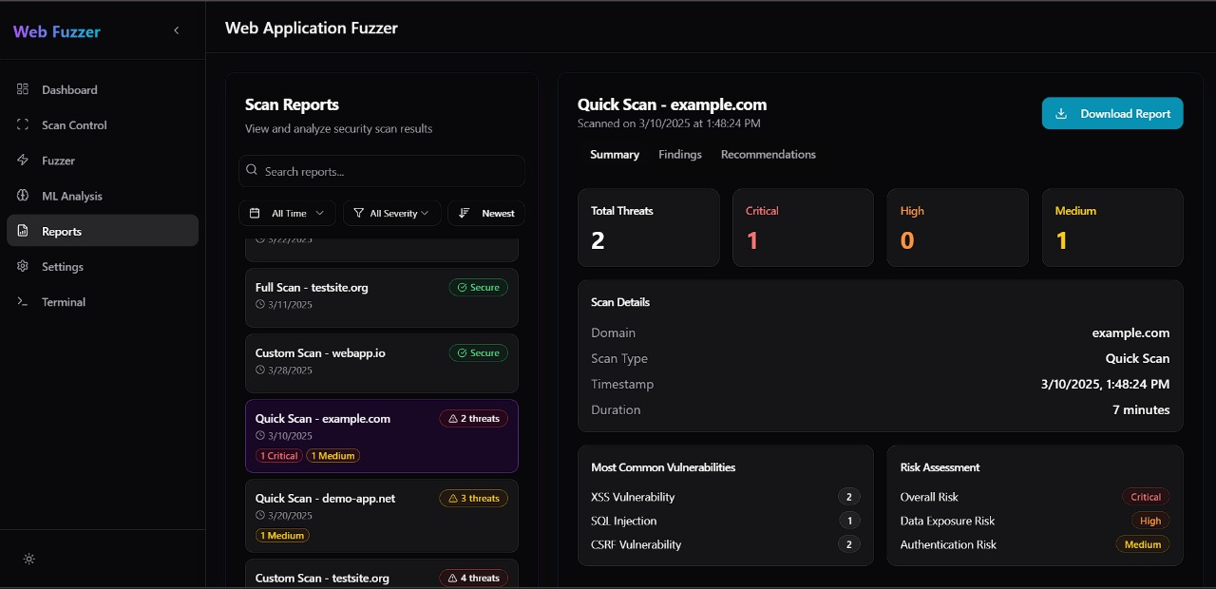
Reports

Slide 33
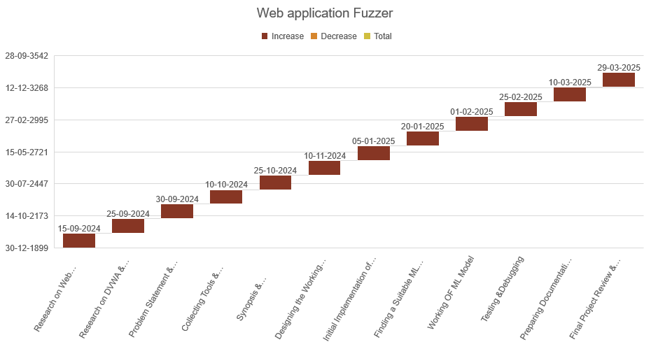
Executing the Machine Learning Model

Slide 34
Conclusion
The web application fuzzer is a critical tool for enhancing web security by automating the process of vulnerability detection.
It can test various web inputs and identify potential threats before they are exploited by attackers.
By providing detailed reports, it helps developers secure their applications more effectively.

Slide 35
References
Godefroid, P., Peleg, H., & Singh, R. (2017). Learn Fuzz: Machine Learning for Input Fuzzing. *32nd IEEE/ACM International Conference on Automated Software Engineering (ASE)*, 50-59.
Sutton, M., Greene, A., & Amini, P. (2007). Fuzzing: Brute Force Vulnerability Discovery. Addison-Wesley Professional.
Oehlert, P. (2005). Violating assumptions with fuzzing. IEEE Security & Privacy, 3(2), 58-62.
Takanen, A., Demott, J. D., & Miller, C. (2008). Fuzzing for Software Security Testing and Quality Assurance.
Assiri, F. Y., & Aljahdali, A. O. (2024). Software Vulnerability Fuzz Testing: A Mutation-Selection Optimization Systematic Review
She, D., Pei, K., Epstein, D., Yang, J., Ray, B., & Jana, S. (2019). NEUZZ: Efficient Fuzzing with Neural Program Smoothing. *IEEE Symposium on Security and Privacy (SP)*, 803-817.

Slide 36
…Thank You !!!

